Slide 1
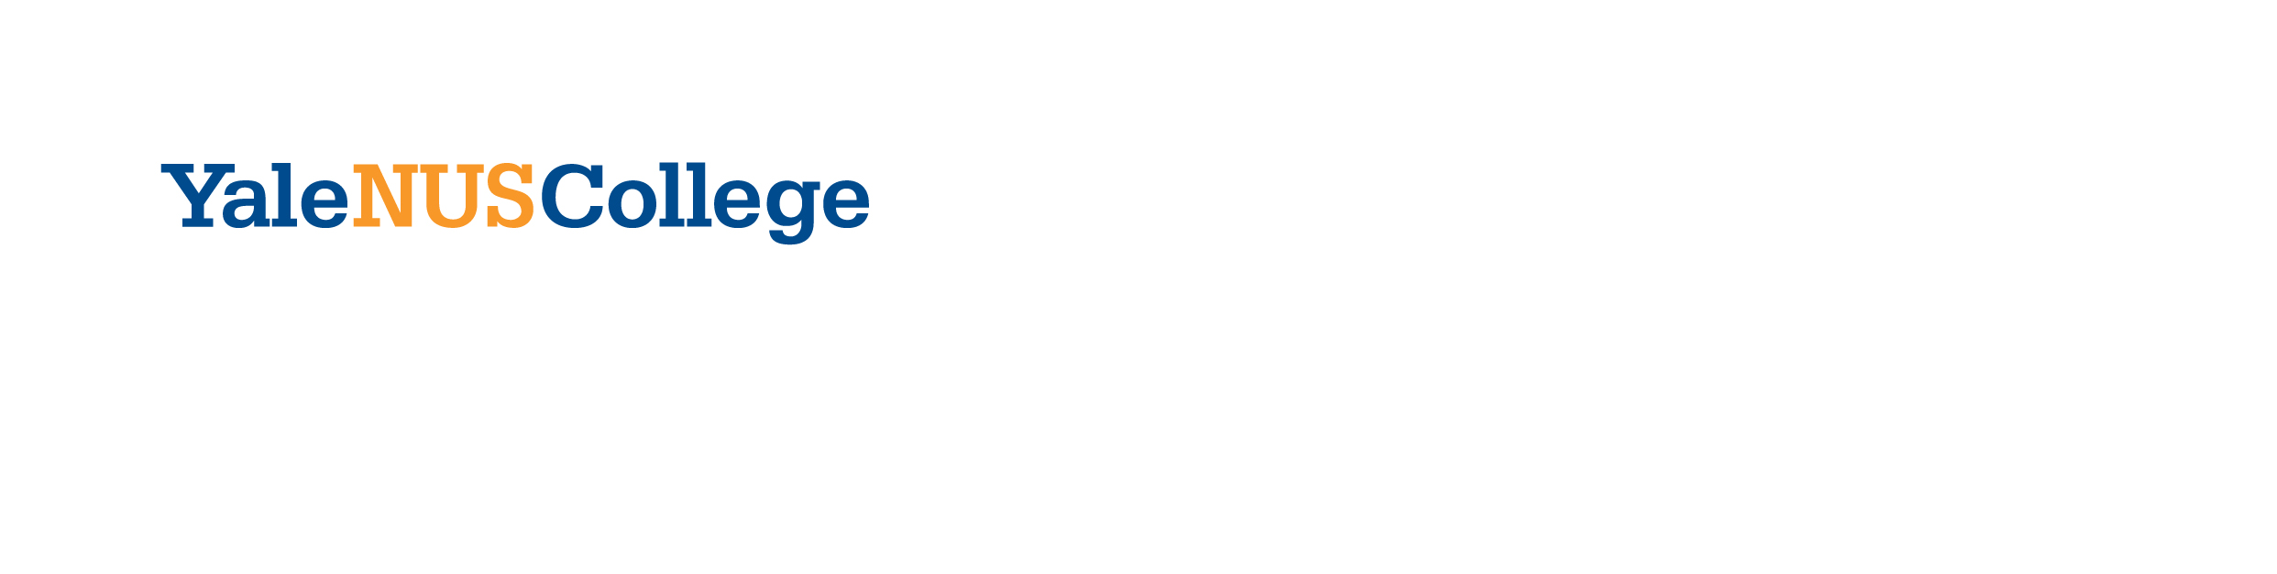
YSC2239 Lecture 17

Slide 2
Today’s class
Variance-bias tradeoff
Overfitting
Cross-validation

Slide 3
Data Generation Process

Slide 4
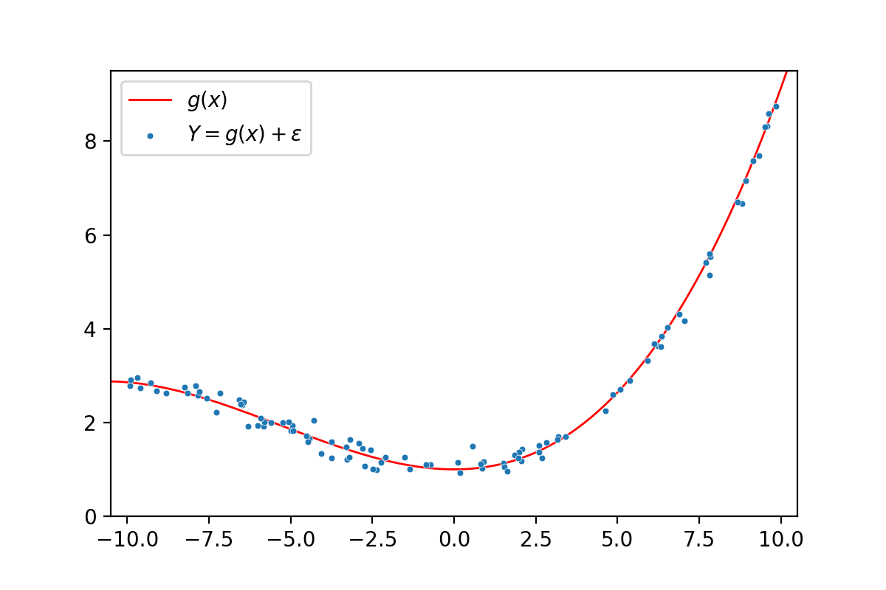
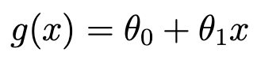
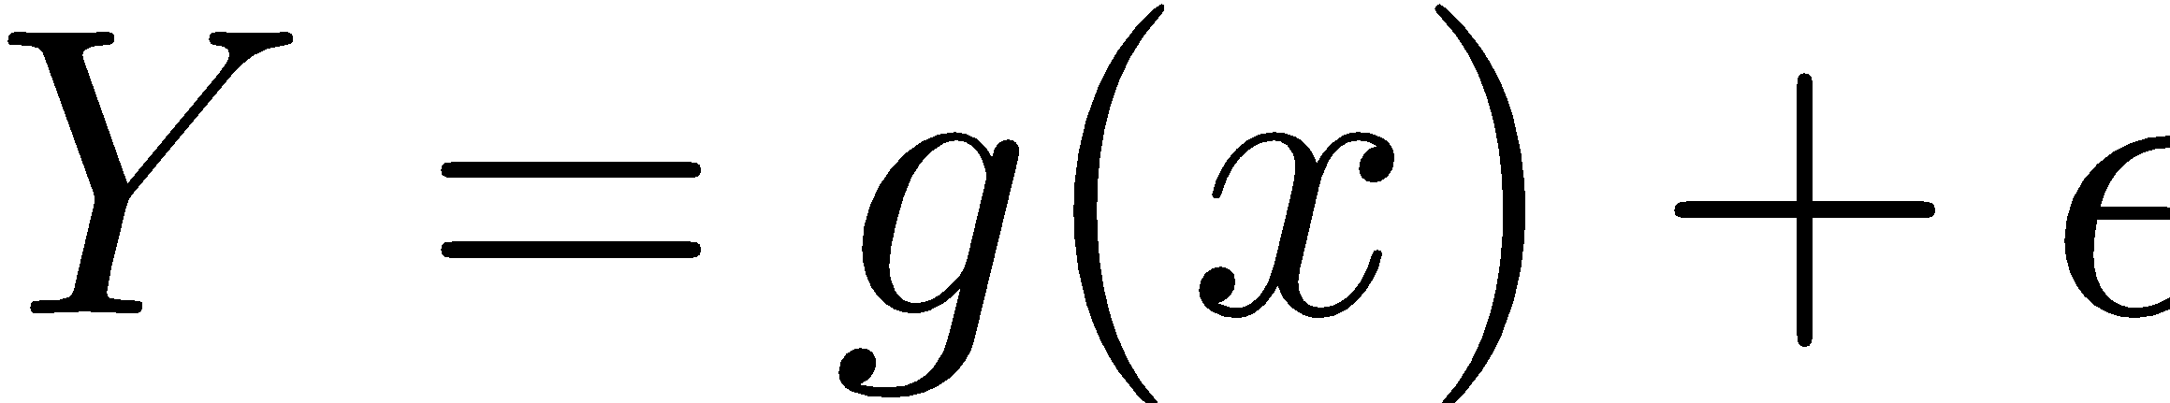
Data Generation Process
Assume true relation g
For example:
For each individual:
fixed value of x, so also g(x)
random error ε
Observation is:
Errors ε have expectation 0, and are “independent and identically distributed” across individuals

Slide 5
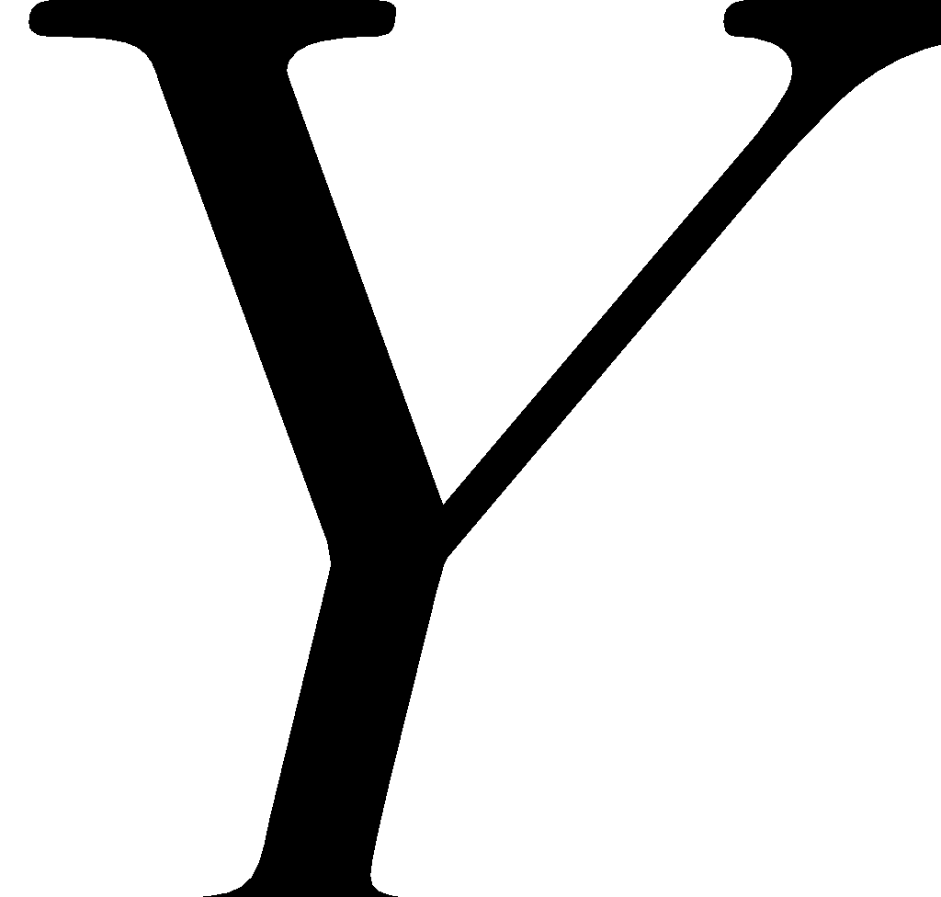
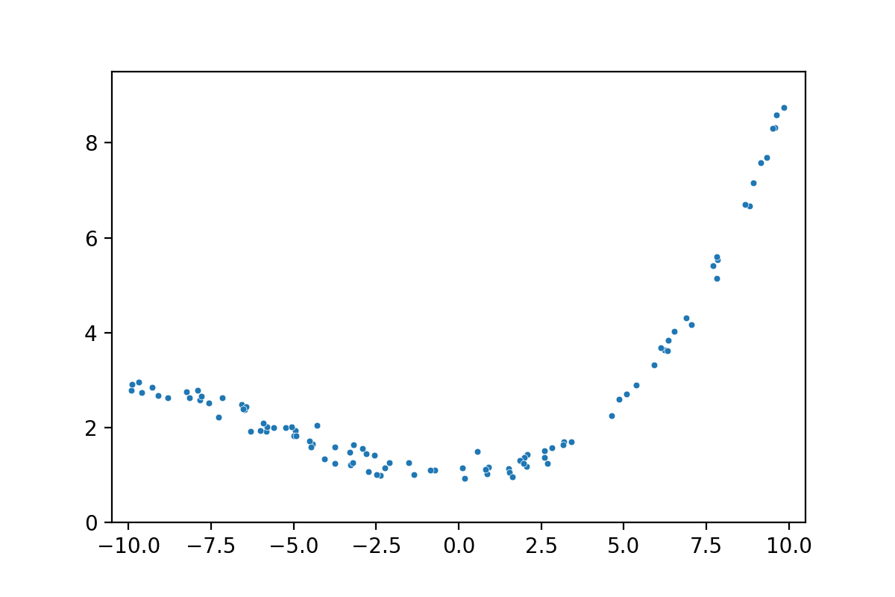
The Data
At each x, truth is g(x)
noise is ε
Observation is
We only see

Slide 6
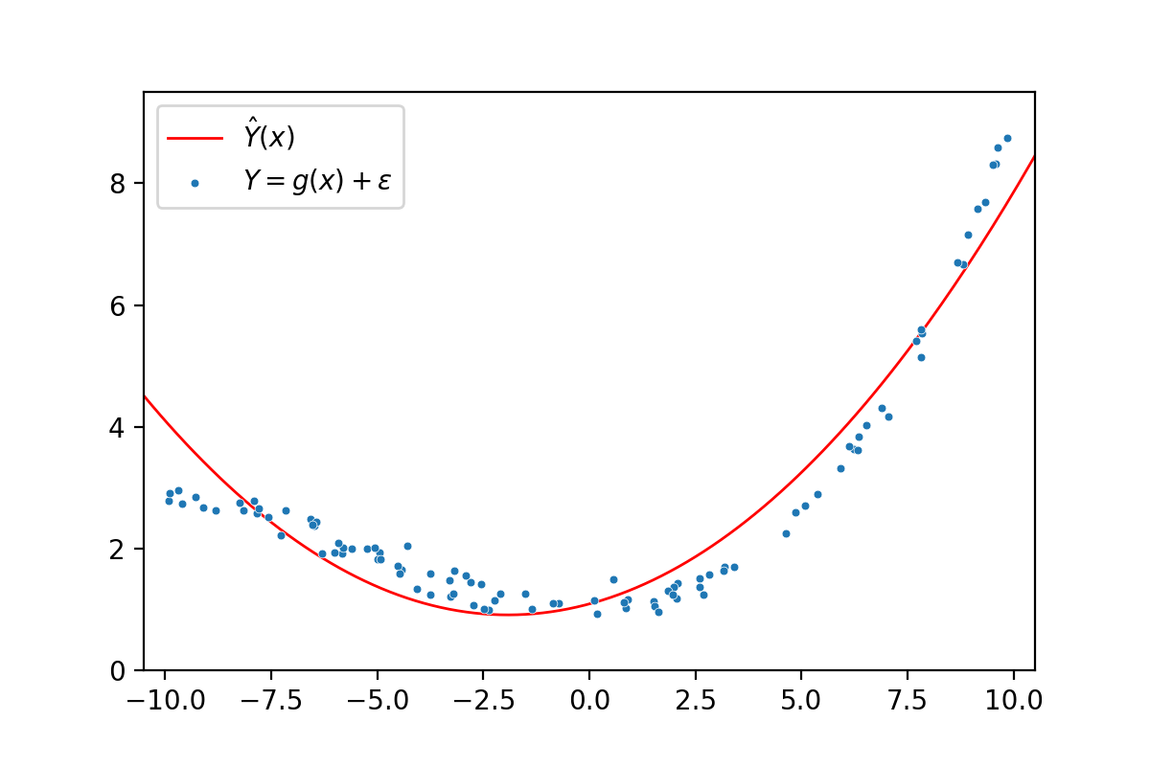
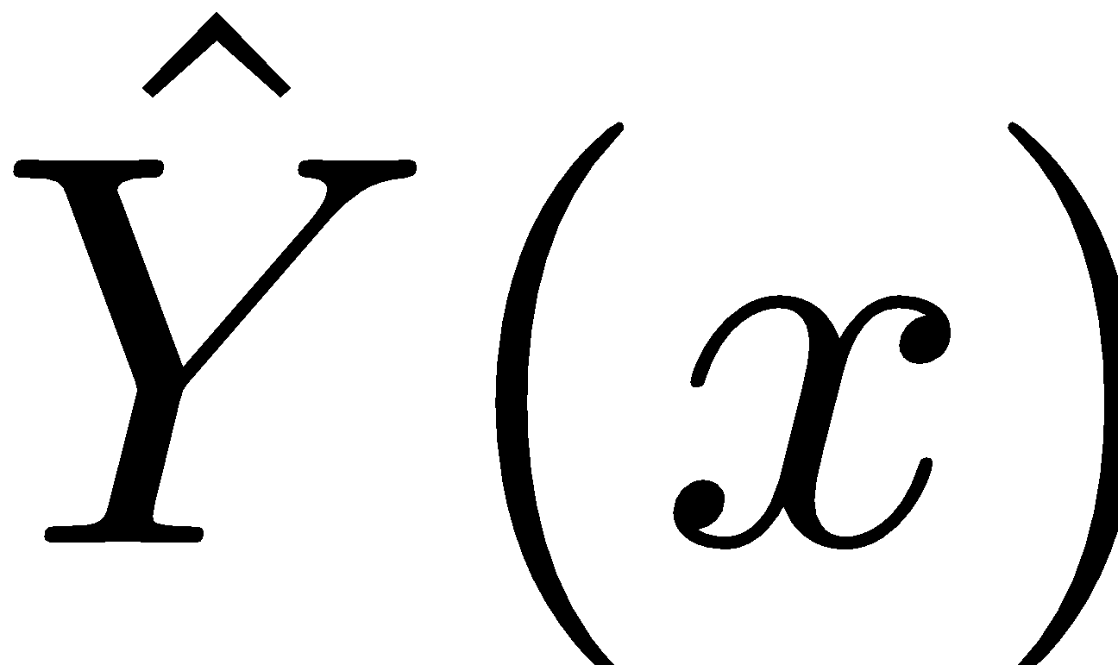
Our Predictions
We choose a model and fit it to our data
Choosing a model is codifying our assumption of the form of g(x)
The red line is our fitted function—the best possible function given g(x)
At every x, our prediction for Y is
the height of the red line at x
Denote this

Slide 7
Bias and Variance in Modeling

Slide 8
A Constant Model
Let’s say you want to estimate how often a coin lands on heads when flipped.
The result of a coin flip follows a Bernoulli(p) distribution, and you want to estimate p.
You do not collect any data, but instead you are given a choice between two models.
Suppose you are also told that p = .5.
Which of the following is the better model?
Model A: Select a random number between 0 and 1. This is your estimate of p. This is equivalent to running np.random.random()in Python.
Model B: Select .75 as your estimate of p.

Slide 9
A Constant Model
How do we define “better”?
We can calculate the expected MSE of each model. This is called the “model risk,” a term which we will formalize later on. The lower the risk, the better.
Model A: On average, we will select .5 as our estimate, so we expect 0 error. But, as we are only selecting one number, there is a chance we select a number really far away from .5.
Model B: With this model, we will never be exactly correct. But, we know there is zero chance of a really terrible prediction.

Slide 10
The Bias-Variance Tradeoff
When building models, we generally face a tradeoff between bias and variance.
Lower bias means that our model will predict closer to the truth, on average.
Lower variance means that our model will not change too much given the sample.
We want low bias and low variance, but oftentimes, when one decreases, the other increases.
Model A has zero bias, but lots of variance. Model B has zero variance, but lots of bias.
So which is better? The answer will be revealed later in the lecture.

Slide 11
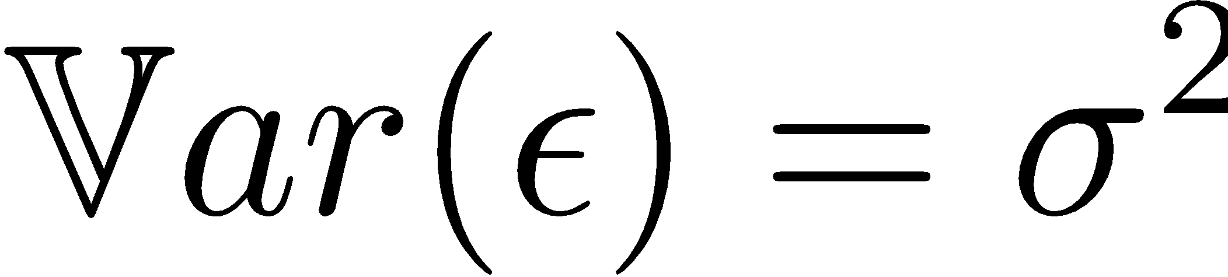
Three Sources of Error in Our Predictions
Irreducible error: Recall the data generating process:
There will be chance error in our predictions due to the natural randomness of the world.
Model variance: Our fitted model is based on a random sample.
The sample could have come out differently, then the fitted model would have been different.
Model bias: This is the difference between the expected predictions, and the true g(x).
Our model may be too limited to find the correct g(x), for example if we pick a quadratic model to fit to cubic data.

Slide 12
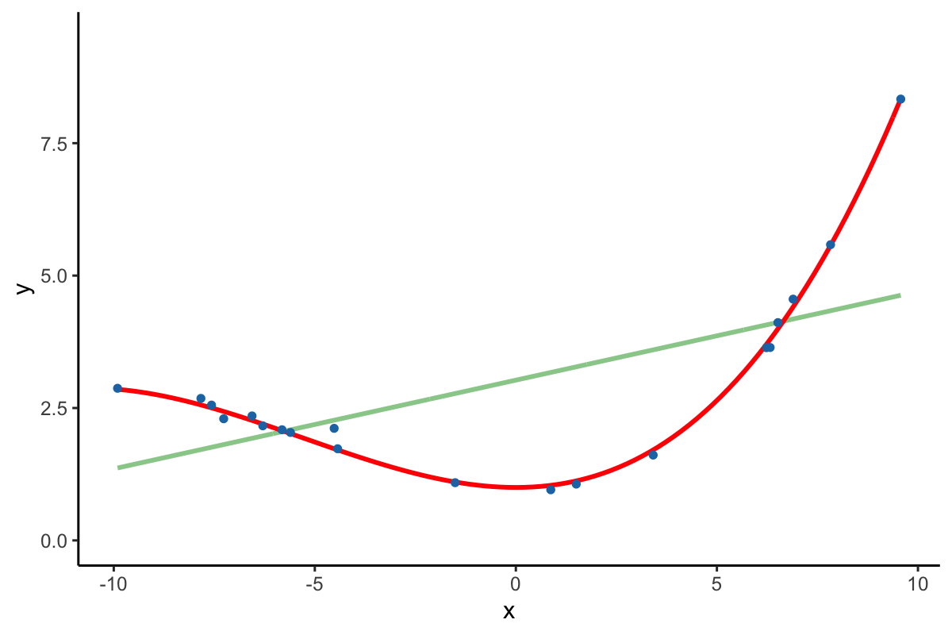
Simulation
Let’s simulate the sampling and modeling process for a strictly linear model.

Slide 13
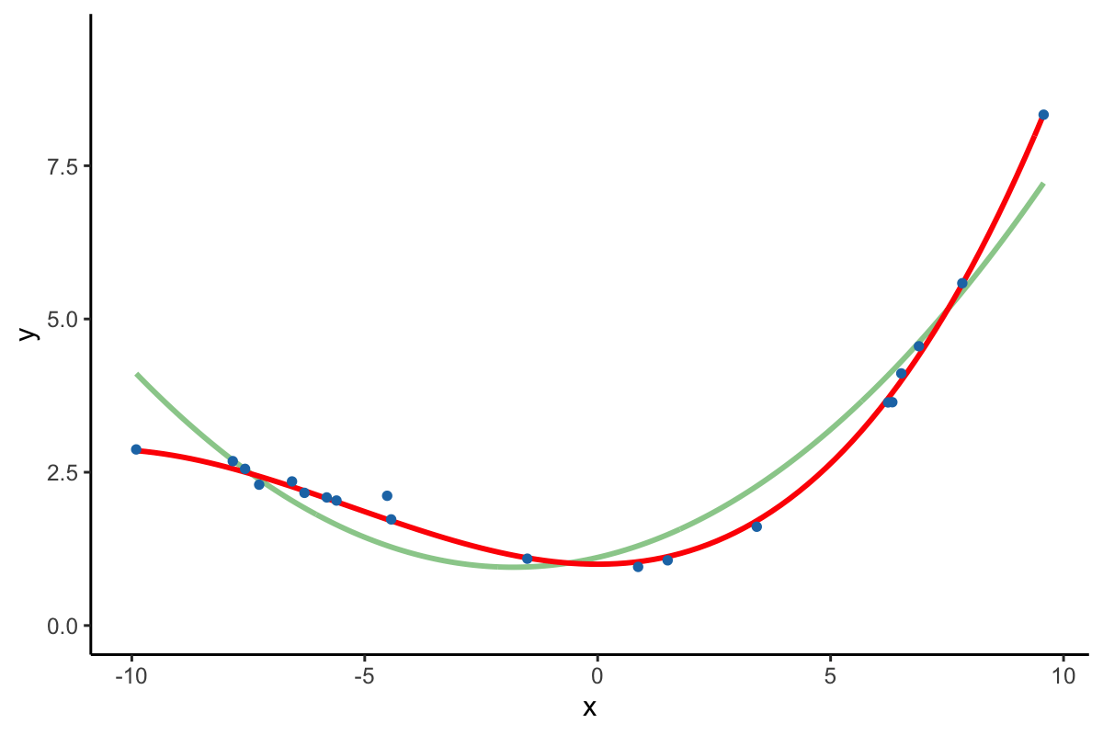
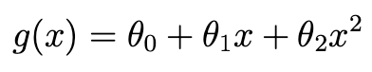
Simulation
Let’s simulate the sampling and modeling process for a quadratic model.

Slide 14
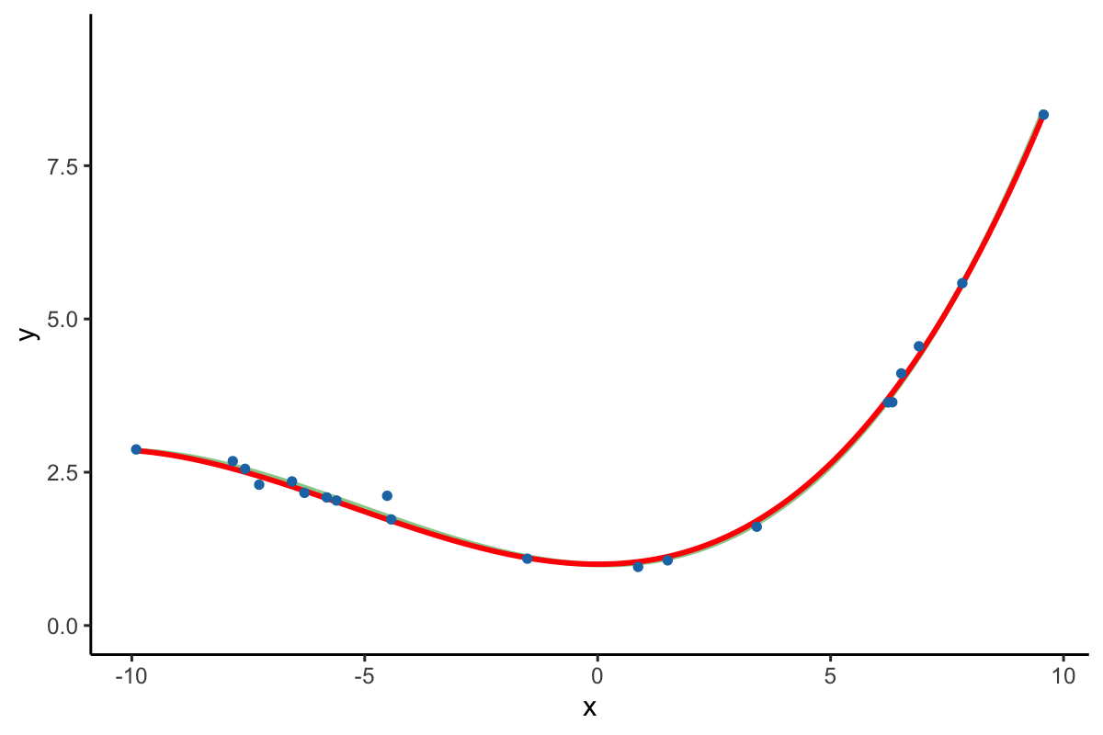
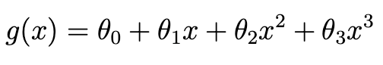
Simulation
Let’s simulate the sampling and modeling process for a cubic model.

Slide 15
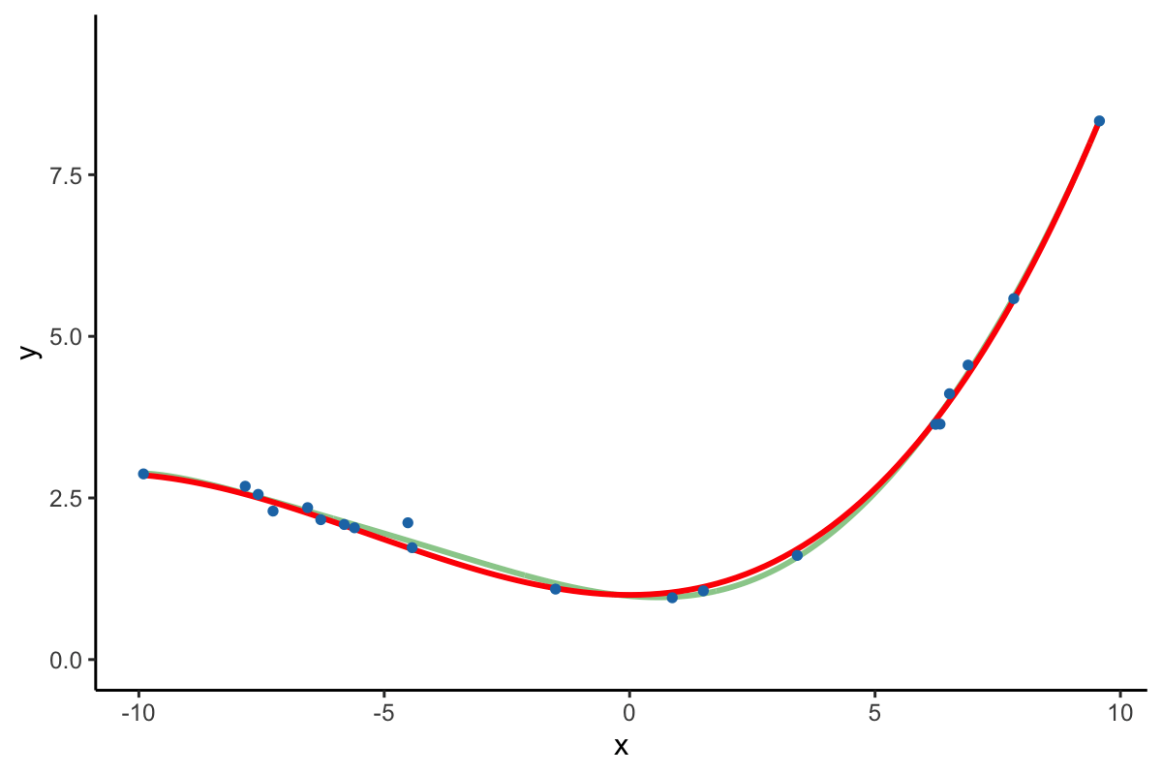
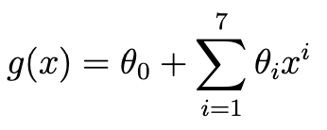
Simulation
Let’s simulate the sampling and modeling process for a septic model.

Slide 16
Decomposition of Risk

Slide 17
Model Risk
For a new individual at (x, Y):
Expected mean squared error of prediction:
The expectation is taken over all possible samples that we could have collected.
Remember, each new sample would generate a different
Also, for some fixed x, Y can be different due to the random error ε

Slide 18
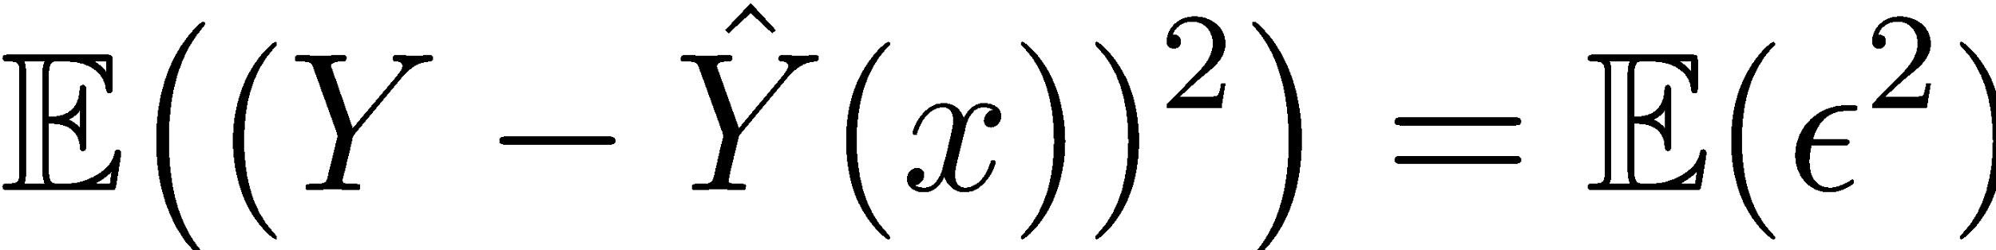
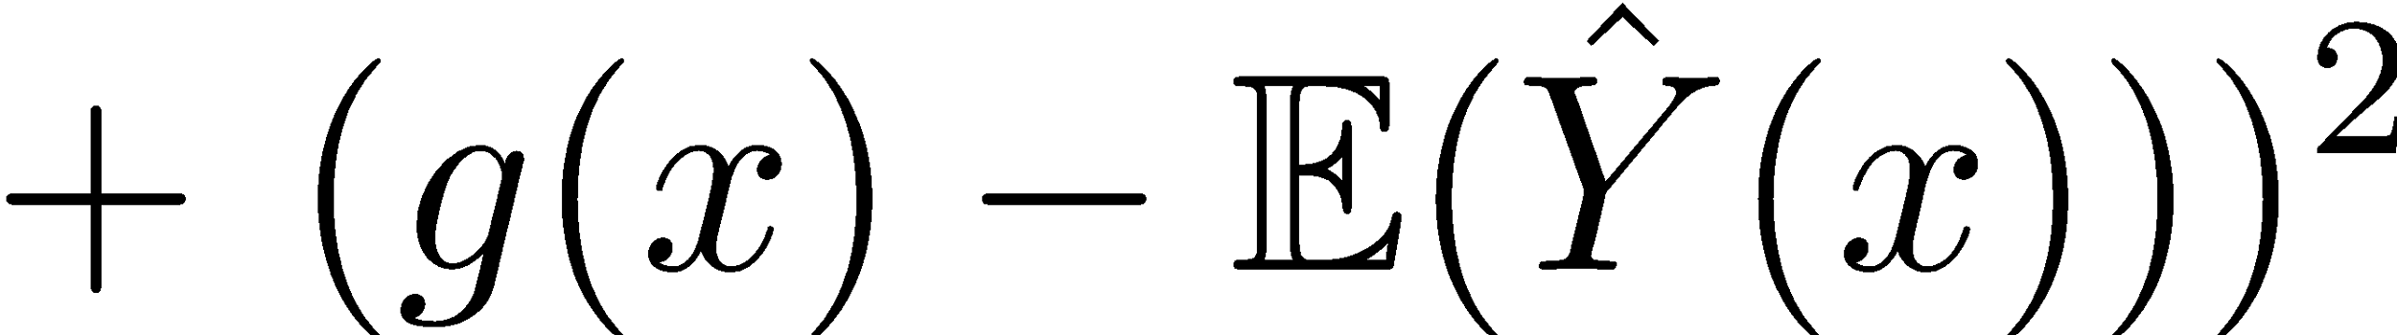
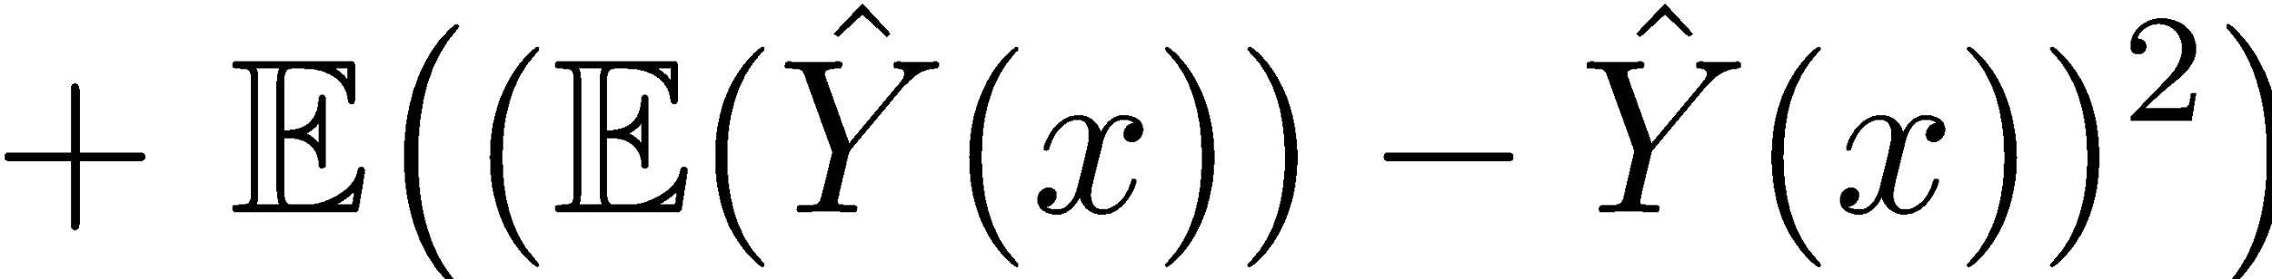
Decomposition of Error and Risk
The model risk can be decomposed into three pieces:

Slide 19
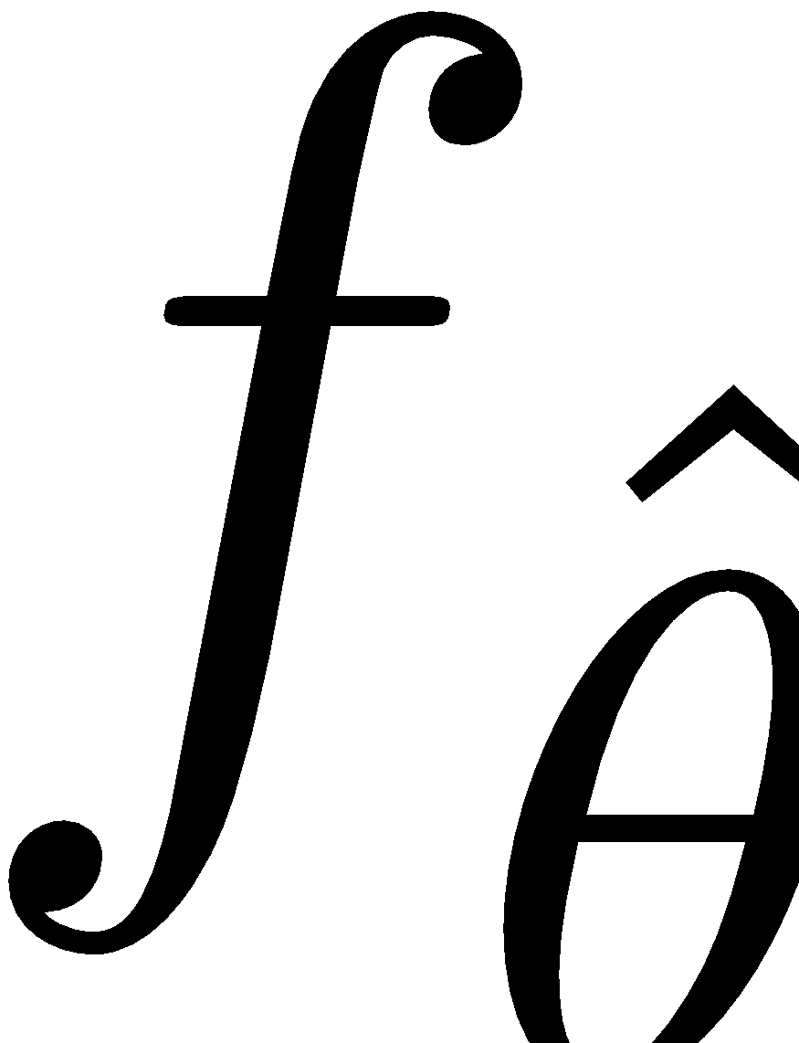
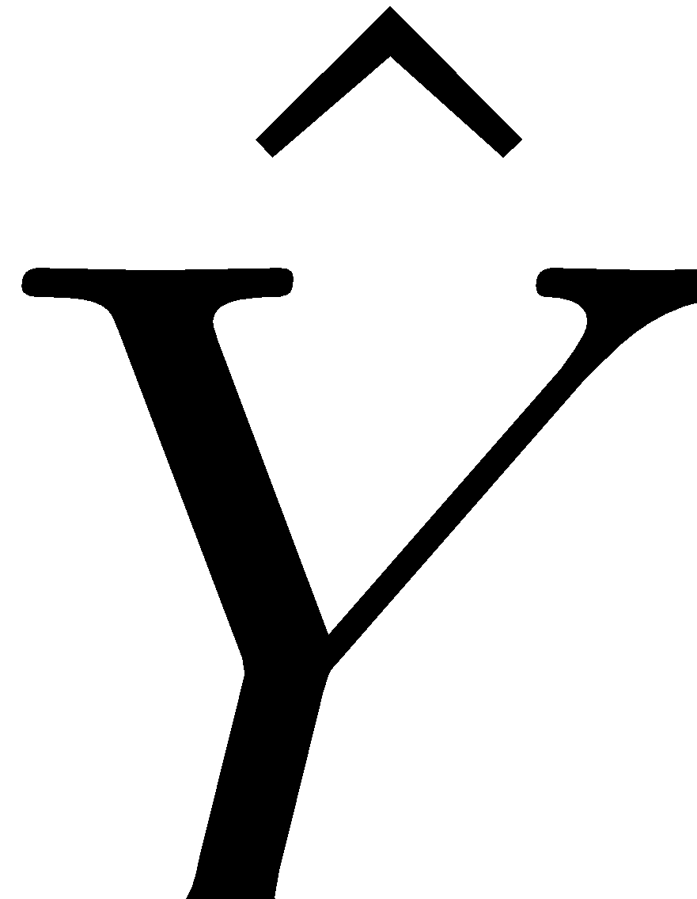
Bias-Variance Decomposition
Remember our assumption about the true relationship g(x). When we fit our model, we find some function that estimates g(x). is random and is just another name for

Slide 20
Observation Variance
Some reasons:
Measurement error
Missing information acting like noise
Some remedies:
Could try to get more precise measurements.
Often this is beyond the control of the data scientist.

Slide 21
Model Variance
Main reason:
Overfitting: small differences in random samples lead to large differences in the fitted model
Some remedies:
Reduce model complexity
Don’t fit the noise

Slide 22
Model Bias
Some reasons:
Underfitting
Lack of domain knowledge
Remedies:
Increase model complexity (but don’t overfit)
Consult domain experts to see which models make sense

Slide 23
A Constant Model
So which model is better? Model A or Model B?
Model A: Select a random number between 0 and 1. This is your estimate of p. This is equivalent to running np.random.random()in Python.
Model B: Select .75 as your estimate of p.
We can calculate the model risks directly. Note that the observation variance is 0.
Model A:
Model Bias = .5 - .5 = 0
Model Variance = (1 - 0)² / 12 = 1/12
Risk = 0² + 1/12 = 1/12
Model B:
Model Bias = .75 - .5 = .25
Model Variance = 0
Risk = .25² + 0 = 1/16

Slide 24
Overfitting

Slide 25
Introduction to Overfitting
In the previous lectures, our goal has been to minimize a loss function (MSE)
We do this by collecting more features, or through feature engineering
However, we only ever evaluated our model on the data on which it was trained
The whole point in building a model is to learn something about the world
Why do we care about finding a if we already know ?
We care about how well our model performs on new data, for which we want to predict

Slide 26
Complexity

Slide 27
Modeling Goals
Try to minimize all three of observation variance, model bias, and model variance.
But
Observation variance is often out of our control
Reducing complexity to reduce model variance can increase bias
Increasing model complexity to reduce bias can increase model variance
Domain knowledge matters: the right model structure!

Slide 28
Bias Variance Plot
Optimal Value
Test Error
Model Variance
(Bias)²
Increasing Model Complexity
Notes:
Image

Slide 29
Cross-Validation

Slide 30
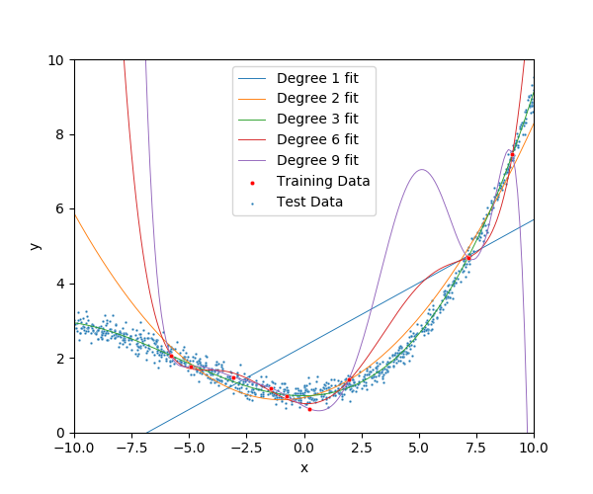
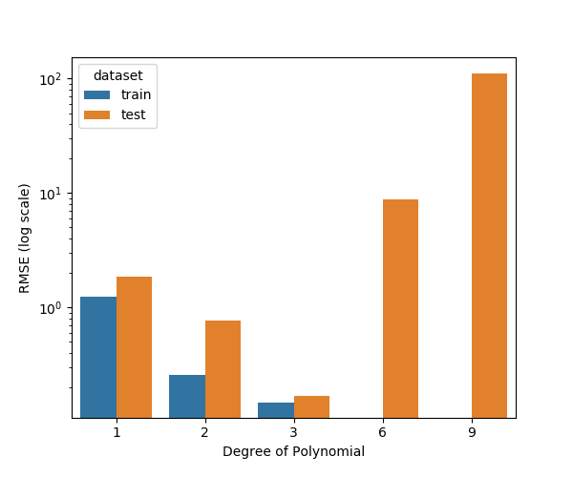
Training Error vs Test Error

Slide 31
Training Error vs Test Error
Underfitting
Overfitting
Test Error
Training error typically underestimates test error.
Best Fit
Error
Training Error
Model “complexity”
(e.g., number of features)

Slide 32
Generalization: The Train-Test Split
Training Data: used to fit model
Test Data: check generalization error
How to split?
Depends on application (usually randomly)
What size? (90%-10%)
Larger training set – more complex models
Larger test set – better estimate of generalization error
Typically between 70%-30% and 90%-10%
Train - Test
Split
Train
Data
Test
You can only use the test dataset once after deciding on the model.

Slide 33
Generalization: Validation Split
V
Train - Test
Split
Validation
Split
Train
Train
V
Train
Train
V
Train
Data
V
Train
Validate Generalization
V
5-Fold
Cross Validation
Test
Cross validation simulates multiple train test-splits within the training data.
You can only use the test dataset once after deciding on the model.

Slide 34
Recipe for Successful Generalization
Split your data into training and test sets (90%, 10%)
Use only the training data when designing, training, and tuning the model
Use cross validation to test generalization during this phase
Do not look at the test data!
Commit to your final model and train once more using only the training data.
Test the final model using the test data.
Train on all available data and ship it!

Slide 35
Demo

Slide 36
Next week
Another strategy to possibly overcome overfitting:
Regularization

